Slide 1
Safe speeds & tactical design
Examples from the greater Portland area and beyond
OMPOC ~ January 2019

Slide 2
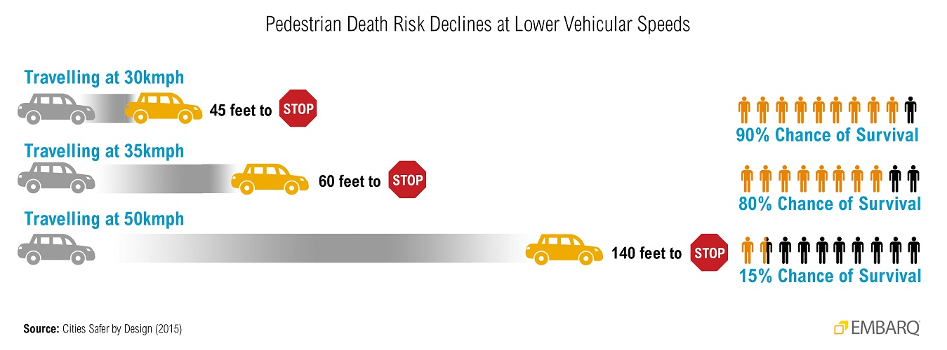
In urban areas, safe speeds account for people traveling in different ways
Speed – and therefore speeding – increases crash risk in two ways:
(1) it increases the likelihood of being involved in a crash
(2) it increases the severity of injuries sustained by all road users in a crash
~National Transportation Safety Board, August 2017
Notes:
In urban places in the region safe speeds must account for people traveling in different ways: walking, driving, using mobility devices, taking transit, biking, skateboarding, etc. It is important to consider people traveling outside of motor vehicles because they are not protected from the impact of crashes. This is why Portland and other cities refer to people traveling outside of motor vehicles as vulnerable users.
Portland uses the following principles to identify safe speed limits:
Less physical separation between people driving and vulnerable users requires a lower speed limit. Sidewalks and protected bike lanes are examples of physical separation between people driving and vulnerable users (see photo below).
Injury crashes are an indicator that speed limits may be too high
PBOT may request speed limit reductions even when street design stays the same. While street design can help people drive at safe speeds, adjustments to speed limits alone can still support safety.
The 85th percentile method is not supported by evidence and is not part of PBOT practice. The 85th percentile method sets speed limits based on the speed at which 85 percent of people drive at or below on a street. The Federal Highway Administration offers a detailed guide on the 85th percentile method and other speed setting approaches.
Speed limits must account for emergency response times. As a general rule, PBOT does not post speed limits below 25 mph on Major Emergency Response Routes, and posts speed limits below 25 mph on Secondary Emergency Response Routes only on a case-by-case basis dependent on review by Portland Fire & Rescue. (View map of Emergency Response Route classifications.)

Slide 3
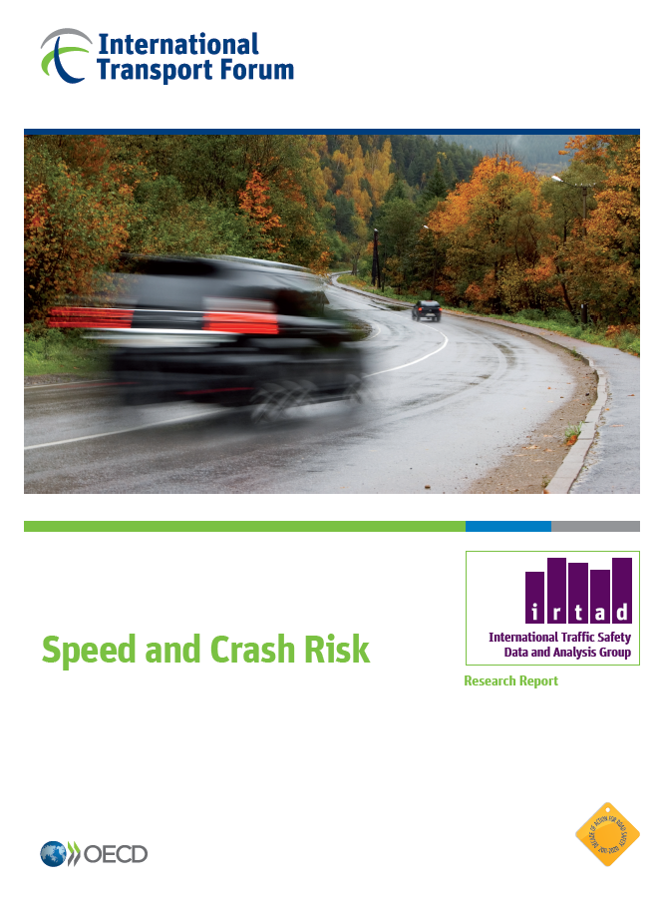
Eliminating serious crashes requires managing speed for safety
“Speed is a very important factor in road crashes. Speed affects the number of crashes as well as the crash severity. This is a consequence of laws of physics that has been supported by large amounts of empirical evidence from all over the world. If on a particular road the average speed increases, then the number of crashes will increase with serious crashes increasing to a larger extent than less serious crashes.”
~International Transport Forum Report on Speed and Crash Risk, October 2018
Notes:
October 2018

Slide 4
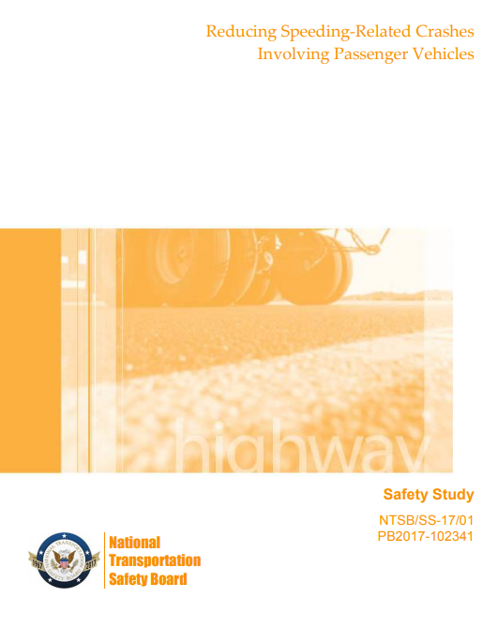
NTSB conclusions and recommendations to reduce speed-related deaths
Focus on:
new methods to set speeds that include a wide variety of factors including vulnerable users
increasing the use of automated enforcement
Incentivizing state and local speed management activities
Incorporate a safe systems approach for urban roads
Safety Study “Reducing Speeding-Related Crashes Involving Passenger Vehicles” National Transportation Safety Board, August 2017
Notes:
National Transportation Safety Board, the nation’s leading authority on crashes and prevention strategies, and its landmark study, published in August 2017, for recognizing the deadly problem of speed and calling for action to dramatically reduce speed-related deaths and injuries.
Conclusion #7: The safe system approach to setting speed limits in urban areas is an improvement over conventional approaches because it considers the vulnerability of all road users.
Conclusion #11: 11. Automated speed enforcement is an effective countermeasure to reduce speeding-related crashes, fatalities, and injuries.
National Transportation Safety Board issued recommendations to dramatically reduce speed-related deaths and injuries and urgently raise public understanding, including
Recommendation #10: Revise Section 2B.13 of the Manual on Uniform Traffic Control Devices so that the factors currently listed as optional for all engineering studies are required, require that an expert system such as USLIMITS2 be used as a validation tool, and remove the guidance that speed limits in speed zones should be within 5 mph of the 85th percentile speed.
Recommendation #11: Revise Section 2B.13 of the Manual on Uniform Traffic Control Devices to, at a minimum, incorporate the safe system approach for urban roads to strengthen protection for vulnerable road users. (Note this section addresses setting speed zones and limits; vulnerable users are not currently included in the list of factors to be considered when establishing or reevaluating speed limits.)
Recommendation #16: To the 15 states with automated speed enforcement restrictions: Amend current laws to remove operational and location restrictions on the use of automated speed enforcement, except where such restrictions are necessary to align with best practices.

Slide 5
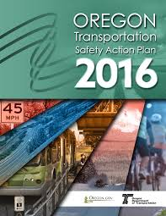
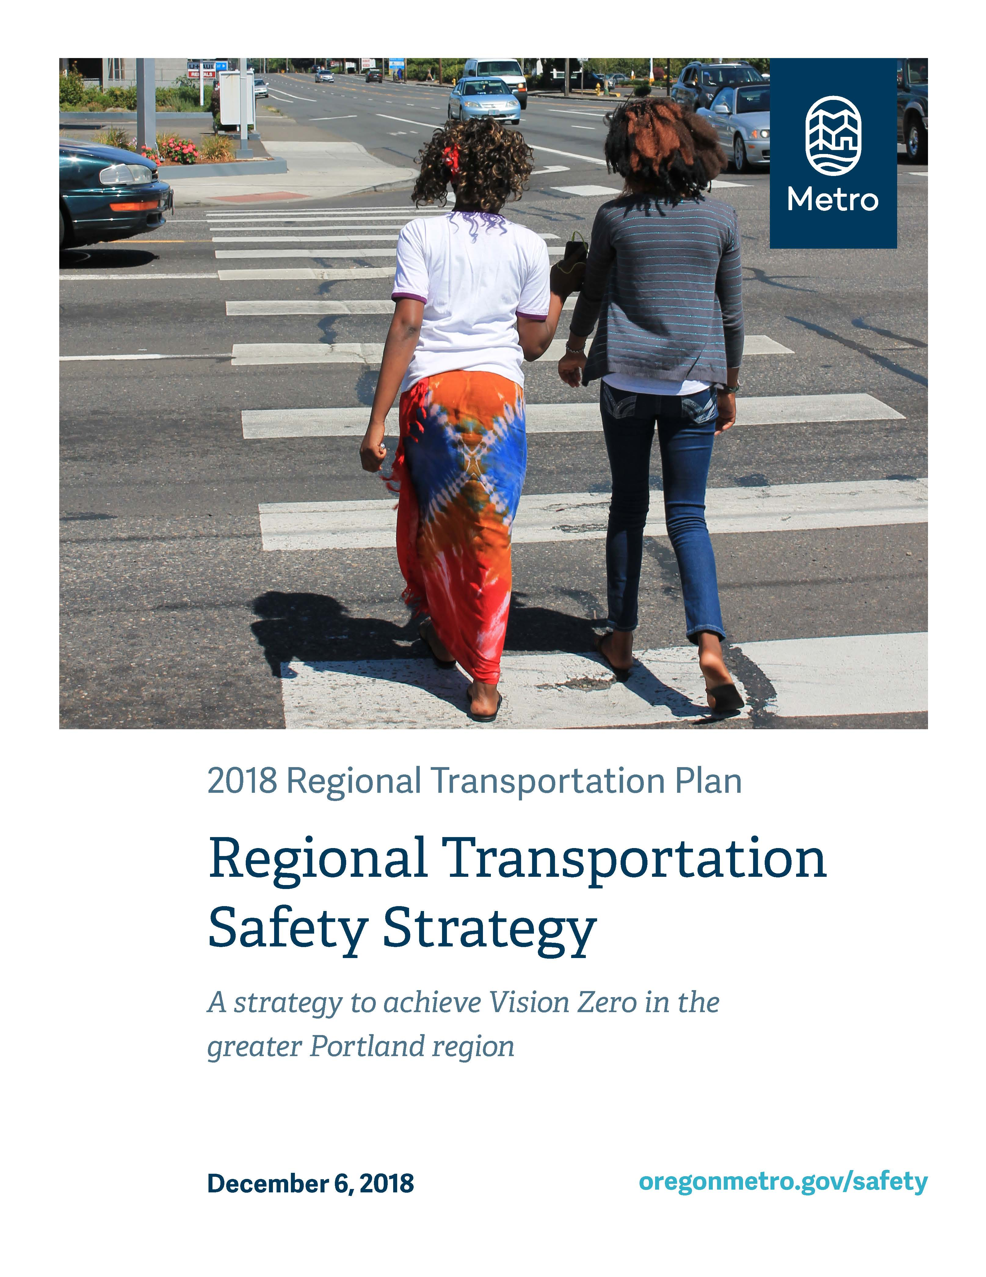
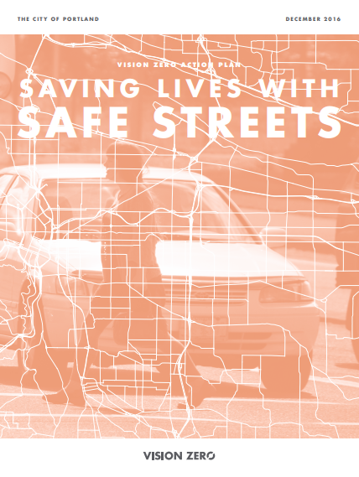
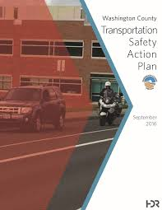
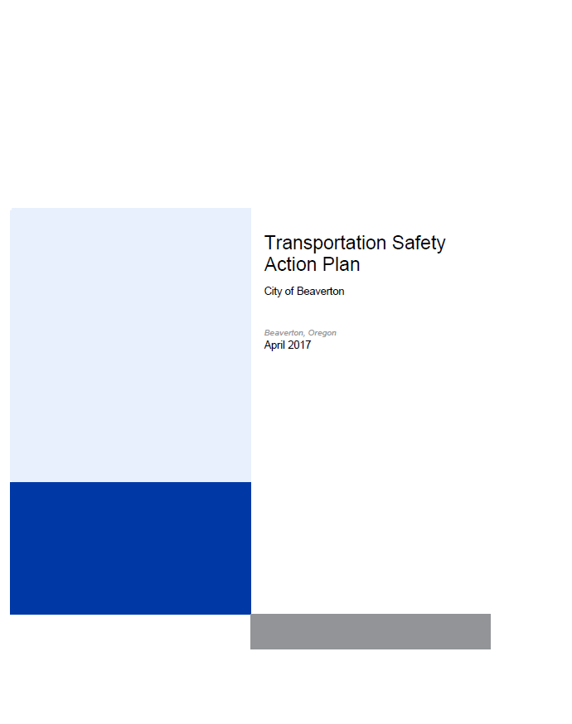
Addressing speed related crashes is a leading strategy in Vision Zero/ Toward Zero Deaths action plans
Notes:
In addition to TSAPs jurisdictions are now developing Speed Management Plans
Metro safety strategy: https://www.oregonmetro.gov/sites/default/files/2019/01/29/2018-Regional-Transportation-Safety-Strategy_FINAL.pdf

Slide 6
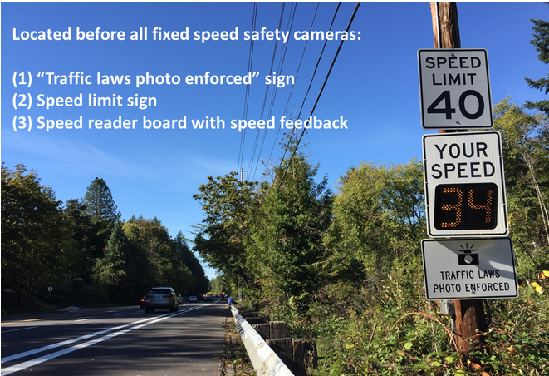
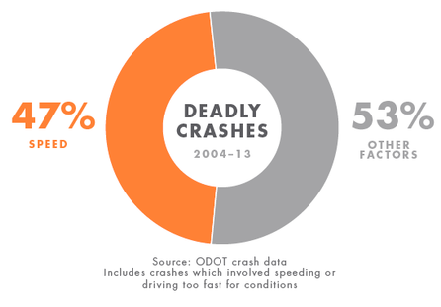
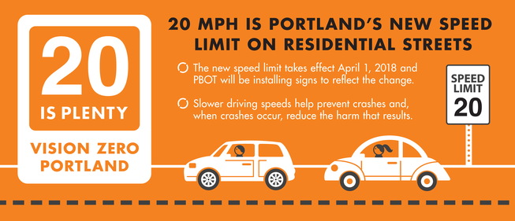
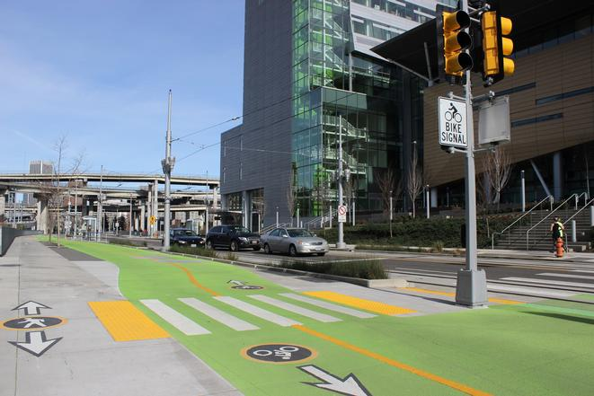
Example: Portland's Vision Zero Action Plan includes 3 actions to support safe speeds
Pilot speed safety cameras
Lower posted speeds,gain local authority for speed reduction on City of Portland streets
Improve street design to support safe speeds
Notes:
Nearly 50% of deadly crashes in Portland involve speed.
Portland's Vision Zero Action Plan includes three actions to support safe speeds:
Pilot speed safety cameras on four high crash corridors in the first two years; expand program to additional high crash corridors following the pilot
Gain local authority for speed reduction on City of Portland streets; prioritize setting safe speed limits in the High Crash Network
Improve street design to support safe speeds in conjunction with posted speed reduction on four to six streets (not including SD.1 improvements) annually in the High Crash Network, prioritizing improvements in and engaging with Communities of Concern

Slide 7
Portland example: Pilot speed safety cameras
A proven safety tool to reduce speeding, can reduce total crashes up to 49% and deadly/serious injury crashes up to 44%*
*Cochrane study: “Do speed cameras reduce road traffic crashes, injuries and deaths?” Nov. 2010
Notes:
https://www.portlandoregon.gov/transportation/70763
Portland is authorized to use speed safety cameras only on its most dangerous streets--its 30 High Crash Network corridors. The High Crash Network represents just 8% of the city’s street network but accounts for 57% of traffic deaths.
Prior to 2015, state law only allowed photo radar systems to be operated in mobile vans for no more than four hours in one location with a uniformed police officer present. This resulted in inconsistent enforcement and a “decay effect” – travelers return to speeding once the van leaves. The newer fixed speed safety camera system provides more consistent and predictable speed control.
PBOT installs speed safety cameras on High Crash Network streets, such as on SW Beaverton-Hillsdale Highway, above. When people drive past the cameras while exceeding the posted speed limit, the cameras capture photos and video for review by Portland Police.
4 cameras are active in four different areas of the city – all on the high crash network:
SW Beaverton-Hillsdale Highway (between Hillsdale Town Center and SW Shattuck Road)
SE Division Street (between 148th and 162nd)
SE 122nd Avenue (between Foster and Holgate)
NE Marine Drive (eastbound near NE 33rd Drive, westbound near NE 138th Ave.)

Slide 8
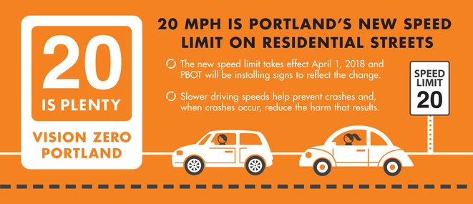
Portland example: Lower posted speeds, gain local authority for speed reduction on city streets
Portland received authority in 2017 to reduce speed limit on all residential streets to 20 mph
Portland is piloting an alternate speed zone investigation method
Portland is pursuing legislation to gain more autonomy over setting speeds in the 2019 session
Notes:
810.180 Designation of maximum speeds; rules
Portland received authority in 2017 to reduce speed limit on all residential streets to 20 mph
Residential streets make up around 70 percent of Portland’s street network and a large proportion of the city’s total public space. Reducing residential speeds is part of a broader citywide effort to support safe driving speeds on many types of streets.
Residential streets exclude federally classified collectors and arterials; has a statutory speed limit (no speed zone order); located in a residence district
Portland is piloting (2 year pilot) an alternate speed zone investigation method for city owned streets, except federally classified arterial roadways (OAR 734-020-0015(3)) which is informing ODOTs current process methods for setting posted speeds. PBOT worked with ODOT to obtain permission to use an alternative method to investigate streets for new speed limits. This method, implemented in late 2016, allows PBOT to request new speed limits using less staff time. The new speed request process also places greater emphasis on vulnerable users and the risk of a future crash. Under the alternative process, PBOT uses the following general guidelines when requesting new speed limits on eligible streets:
20 mph maximum on shared space streets – people walking, biking, scootering, and driving share the same space.
20 to 30 mph maximum on streets with busy intersections & crash history, where sidewalks are unbuffered from driving lanes, or where bike lanes are immediately adjacent to driving lanes.
20 to 40 mph maximum on streets without a median barrier or where there is no physical separation between people traveling in motor vehicles and people traveling outside of motor vehicles.
City is pursuing a policy position to gain more autonomy over the speeds of city owned roadways in the 2019 State legislative session, on city owned arterial roadways the most dangerous
https://www.portlandoregon.gov/ogr/article/703191

Slide 9
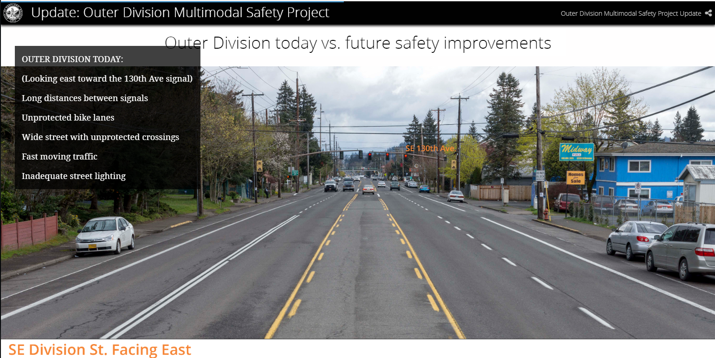
Portland example: Improve street design to support safe speeds
Street design improved in conjunction with posted speed reduction
Corridor safety projects and “quick build” projects
Notes:
Four to six streets annually on the High Injury Corridor
The City of Portland standard is to design streets and street retrofits to the posted speed limit to ensure that all design elements of the street convey to drivers the appropriate speed. This is different from a traditional approach of designing streets to actual auto speeds, regardless of the posted speed limit.
In addition to signage, PBOT has many street design tools available to align speed limits with actual driving speeds. These tools include lane widths, traffic signal timing, curb extensions, and landscaping. In addition, police officers and speed safety cameras help align speed limits with actual travel speeds.

Slide 10
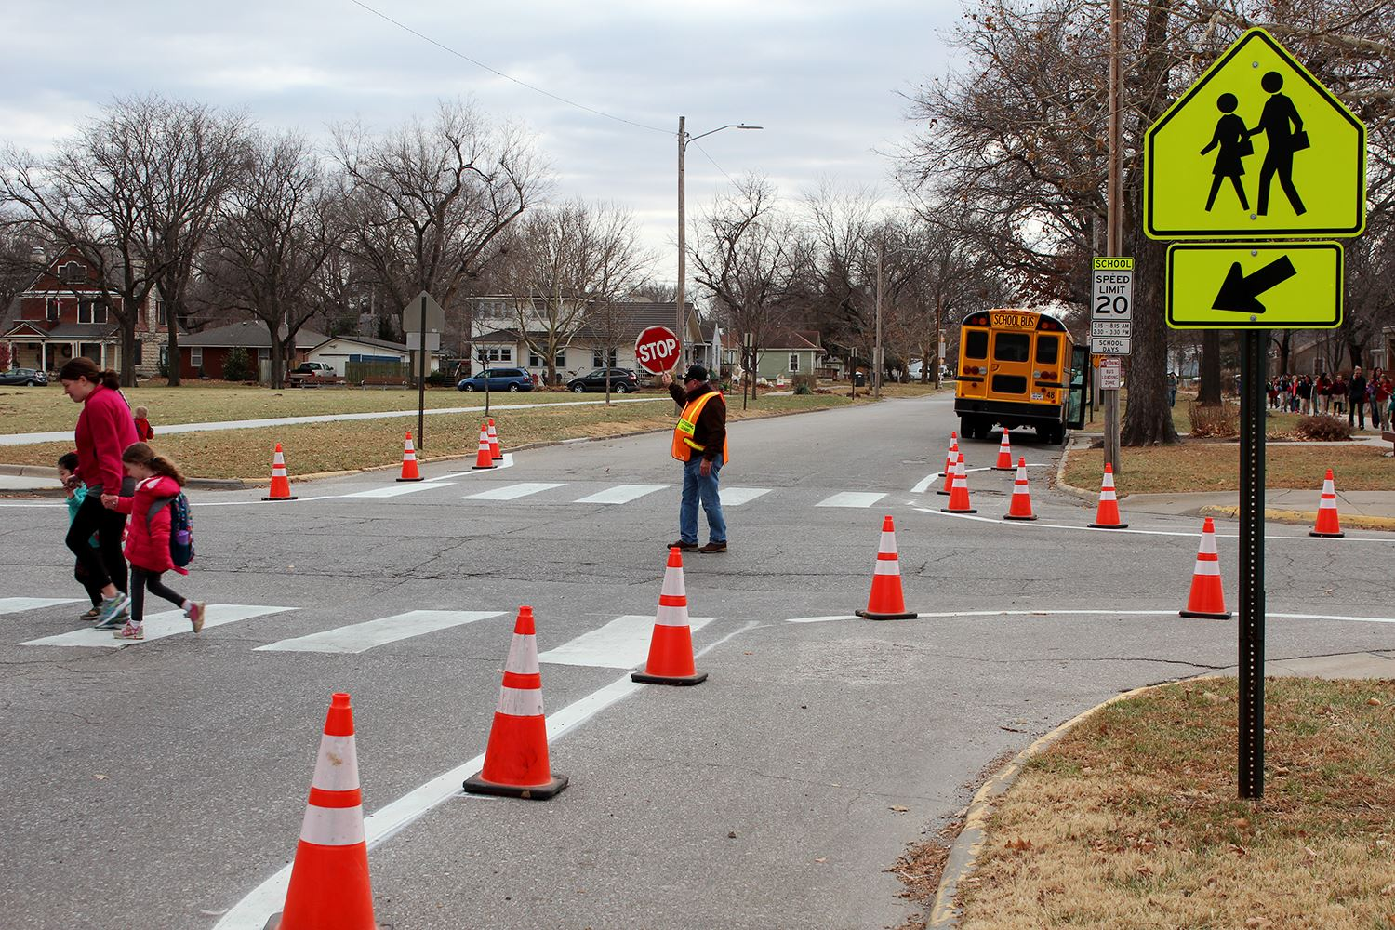
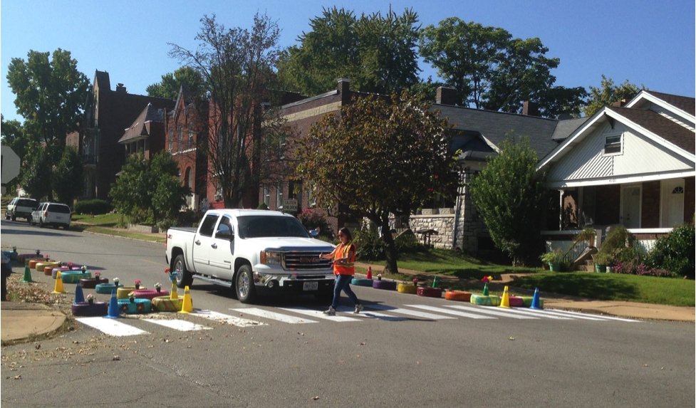
Tactical design: an immediate strategy for slowing speeds & testing new designs for safety
Calming a speedy intersection in Manhattan, KS speeds in St. Louis
Slowing speeds in St. Louis

Slide 11
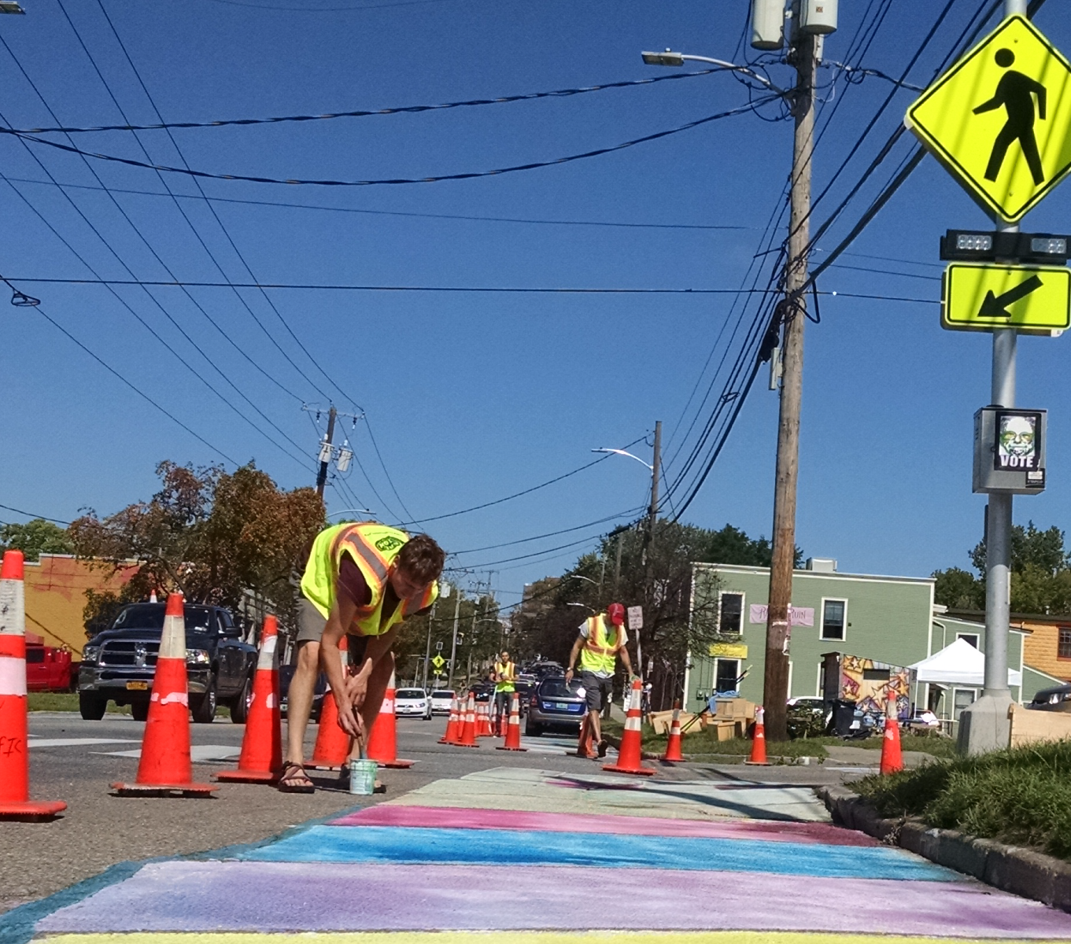
What is tactical design? Pedestrian plazas, pop-up bike lanes, painted freight aprons, crosswalks
Safety is a driver
Flexible, short-term and low-cost to advance long-term goals
Encourages innovation
Community involved or driven
Test – data-driven to avoid getting it wrong
Notes:
AKA tactical urbanism
Tactical Urbanism projects can be led by governments, non-profits, grassroots groups, or frustrated residents. Though the degree of formality may vary, Tactical Urbanism projects share common goal of using low-cost materials to experiment with and gather input on potential street design changes.
Over the past decade Tactical Urbanism has become an international movement, bringing about a profound shift in how communities think about project development and delivery.

Slide 12
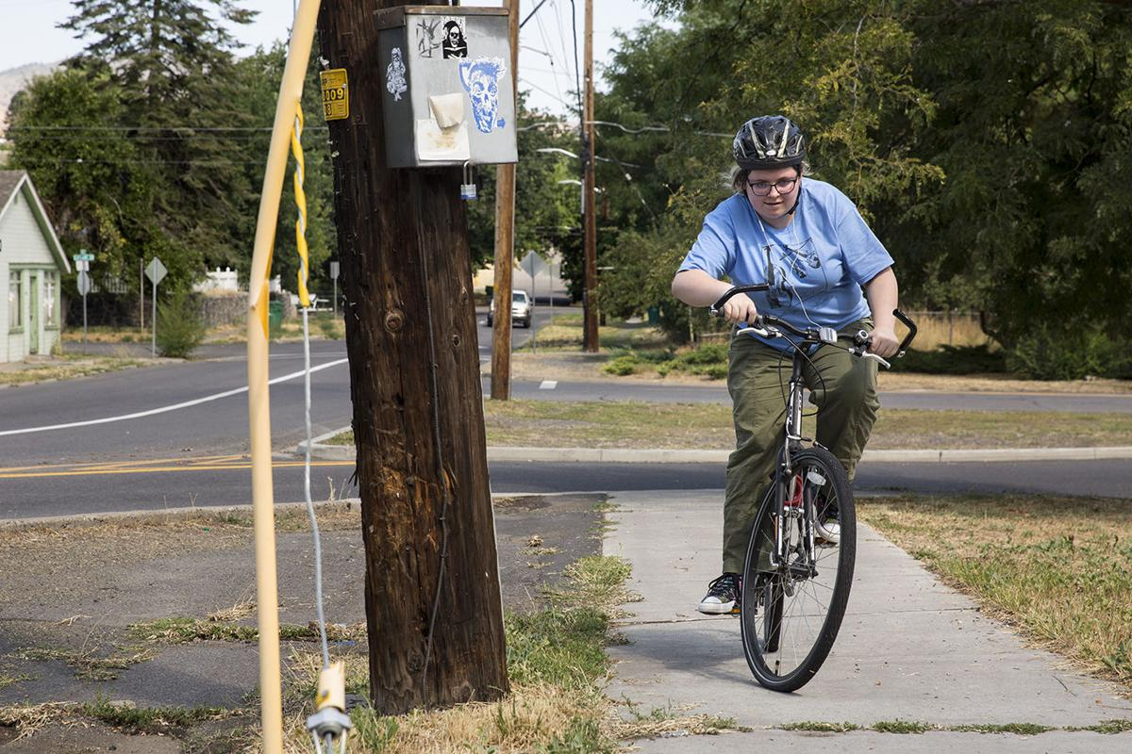
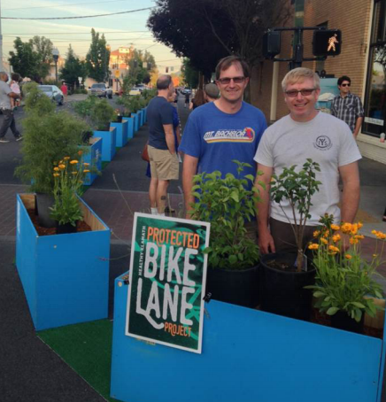
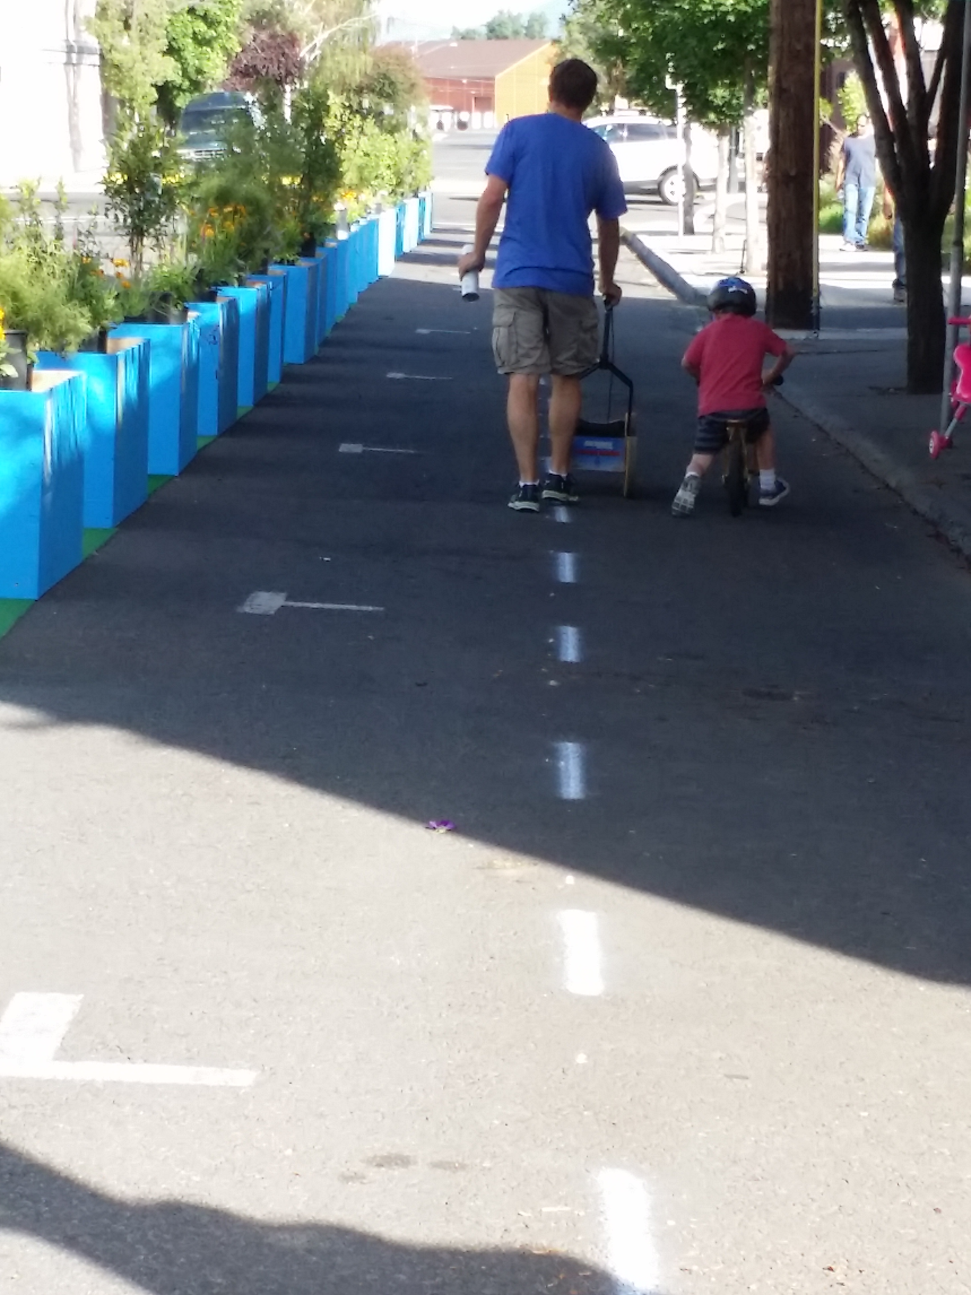
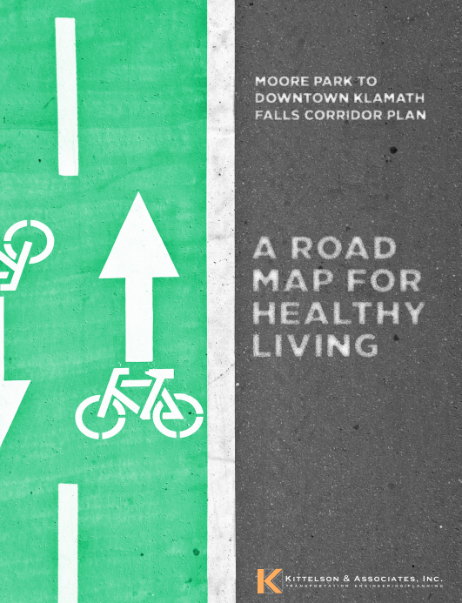
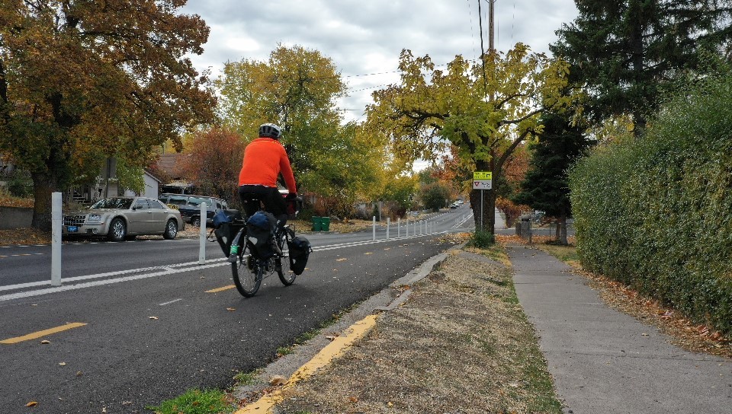
Klamath Falls bike corridor ~ from pop up to permanent
Notes:
2015 – pilot pop up bike lane
2017 back to normal
2018 protected bikeway
In June 2015, Sky Lakes and Healthy Klamath partnered with Klamath Falls to do a pilot demonstration of a protected bike lane during Klamath Falls’ Third Thursday Downtown event. The “pop-up” protected bike lane, made of planter boxes, demonstrated the idea of a protected bike lane and helped build awareness and public support for the idea.
Healthy Klamath: Sky Lakes Medical Center, Klamath County Public Health, Klamath Open Door Family Practice, and Cascade Health Alliance, a community-based effort to improve the health and well-being of Klamath County residents.
Cambia Health Foundation

Slide 13
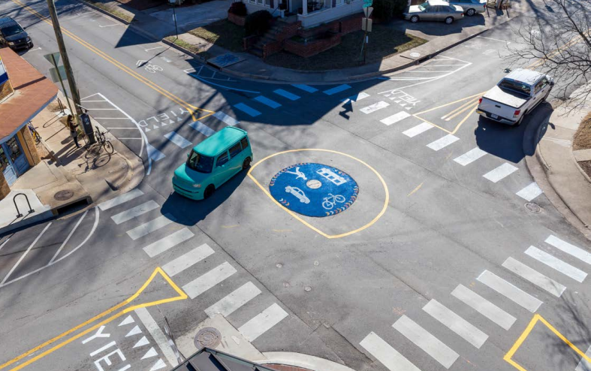
Fayetteville, AK – city program
Mini-roundabout pilot project – paint, mountable center dome – installed in one day for $2,600 (including cost to remove)
Findings from project are informing decisions for permanent treatments
Notes:
Pop. 85,257
Report: https://fayetteville-ar.gov/DocumentCenter/View/12580/Mini-Roundabout-Report-?bidId=
2017 – three month installation of a temporary mini-roundabout to improve pedestrian and bicyclist connectivity.
City staff, elected officials, regional bike and pedestrian advocacy groups, local business owners, and University representatives attended a Tactical Urbanism workshop in November, 2016 to learn about the methodology and identify possible pilot project types and locations in Fayetteville. Consultants from the Street Plans Collective instructed attendees in the techniques, materials, and rationale behind a Tactical Urbanism approach and led the group in a site planning workshop.

Slide 14
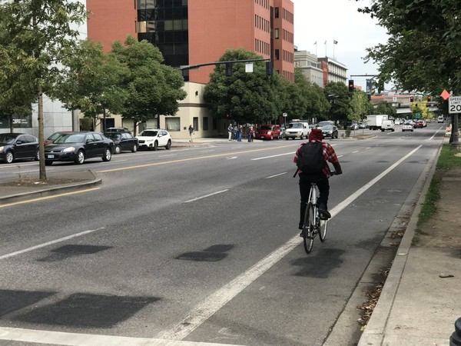
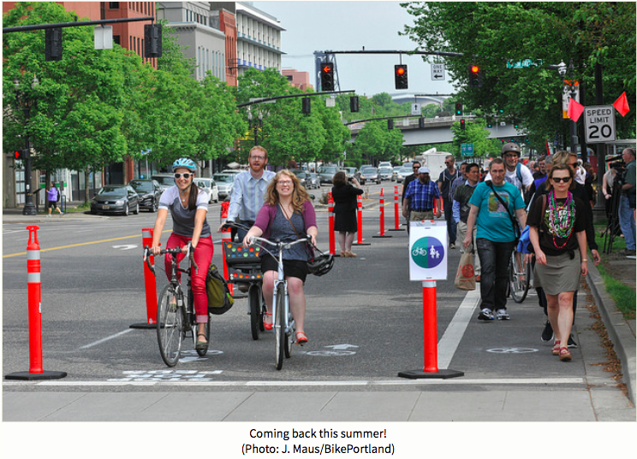
Better Naito, Portland
Notes:
This is the third year of the Council-approved, 5-year implementation of Better Naito. Like past years, PBOT will install plastic posts to delineate one northbound motor vehicle lane on Naito Parkway between SW Main Street and NW Couch Street. There will also be a designated passenger drop off zone on SW Taylor Street to better accommodate people being dropped off by personal vehicles, taxis, and rideshares.
This year January through September

Slide 15
Floating bus stop, Portland
Notes:
May 2016 - For a full week this month, a coalition of businesses and residents tested what it might look like to change NE Broadway from a three lane one-way speedy arterial to a slower and more business friendly retail street. Two community groups, the Broadway-Weidler Alliance and Northeast Broadway Business Association, teamed up with Better Block PDX for a one-week test that redesigned nearly a mile of the street with marked crosswalks, a handbuilt floating bus stop and extra sidewalk space for cafe seating. On the block with the bus stop, the design included a parking-protected bike lane. The crosswalks were sponsored by AARP Oregon. A Chinese restaurant, a taco bar and a credit union bought sponsorships for temporary bike parking racks. The designs were reviewed and approved by the city transportation bureau. City engineers installed traffic-count tubes and travel-time detectors to collect data on the test. “I think slowing down traffic is a good thing, because it gets people to see more,” Mike Chronister, manager of Kitchen Kaboodle.
https://brokensidewalk.com/2016/tactical-bike-lanes-portland-or/

Slide 16
SW Broadway, Portland, one-day-only pop-up protected bike lane
Notes:
https://bikeportland.org/2016/02/11/a-closer-look-at-the-better-broadway-pop-up-protected-bikeway-174752
Feb 2016 Conceived of and implemented by PlaceMatters (Denver), Alta Planning and Design and Better Blocks PDX – way to test how various materials work for rapidly deploying bike lanes and cross-walks, and to test the project for a longer, semi permanent installation.
Better Blocks is now partnering with PSU to put together annual demos – integrating tactical urbanism with an academic student curriculum

Slide 17
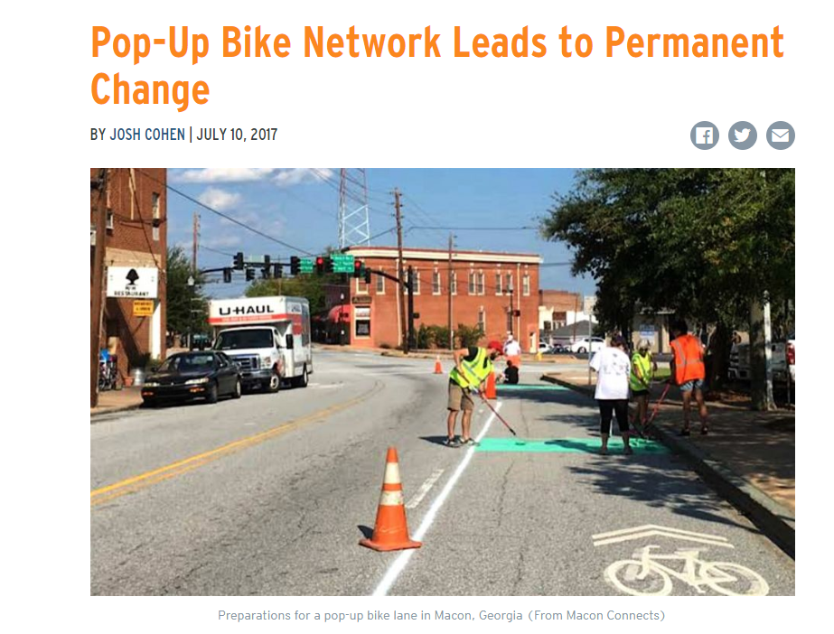
Bike lane network in Macon, GA
Macon Connects installed 8 miles of temporary bike lanes in downtown Macon – number of cyclists went up from 80 a day to 200 a day
Notes:
https://nextcity.org/daily/entry/macon-pop-up-bike-network-permanent-bike-lanes
Town of 114,000
Macon Connects: collaboration between Macon economic development non-profit NewTown Macon, Better Block Foundation and 8-80 Cities (mobility for all). Grew out of 2015 downtown master plan. connects to popular waterfront trail (that could only be safely accessed by driving). Won grant funding for the project to build temporary bike lane network. Surveys found that people preferred the protected infrastructure over unprotected lanes and sharrows.
Led to installation of permanent 3 miles of traditional un-buffered bike lane on a state-owned thoroughfare in downtown Macon. “It felt a little like tilting at windmills advocating for bike lanes before this event,” he says. “The event just changed minds about what’s possible and opened up a world of possibility.” – Josh Rogers president of NewTown.

Slide 18
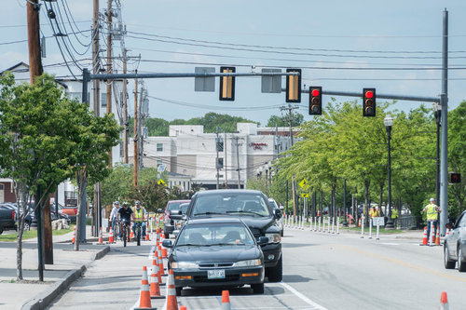
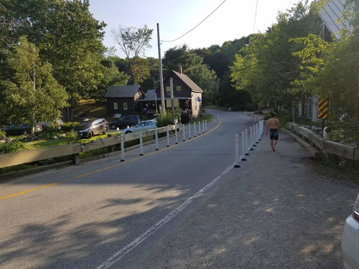
Portland, ME Lightening Grants
Notes:
Population of 67,000
Build Maine – a conference designed to get stuff done
Provides tactical urbanism lightening grants
The purpose of the program is:
To promote greater communication between residents, municipal staff, elected officials, state officials, and stakeholders.
To fund and demonstrate the benefits of iterative improvements made possible by low-cost installations.
To fund and demonstrate the benefits of testing ideas before spending significant funds to install permanent changes.
To gather data that can be used to inform conversations and decisions at the state and local level.

Slide 19
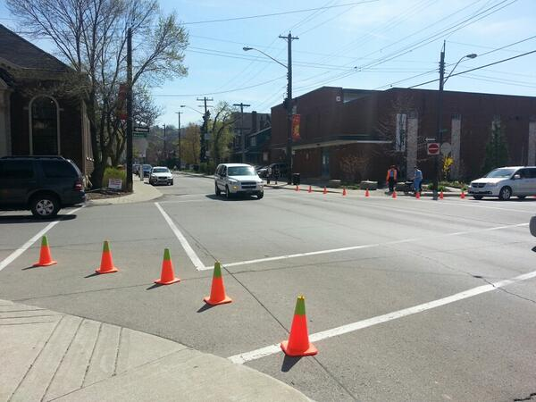
Hamilton, Canada ~ “guerrilla bumpouts”
“I like it!” The long time crossing guard did not know who had installed the cones, but she thought that they made the corner a lot safer for kids walking to school
DIY bumpouts at a busy intersection next to a school
Notes:
Hamilton, a city 45 minutes west of Toronto, almost every street downtown is a one way speedway; some are five lanes wide.
After a public talk by a prominent tactical urbanist (hosted by the city) (Mike Lydon, Street Plans Collaborative NYC) – the city saw many guerrilla pop up projects installed over night by unknown citizens.

Slide 20
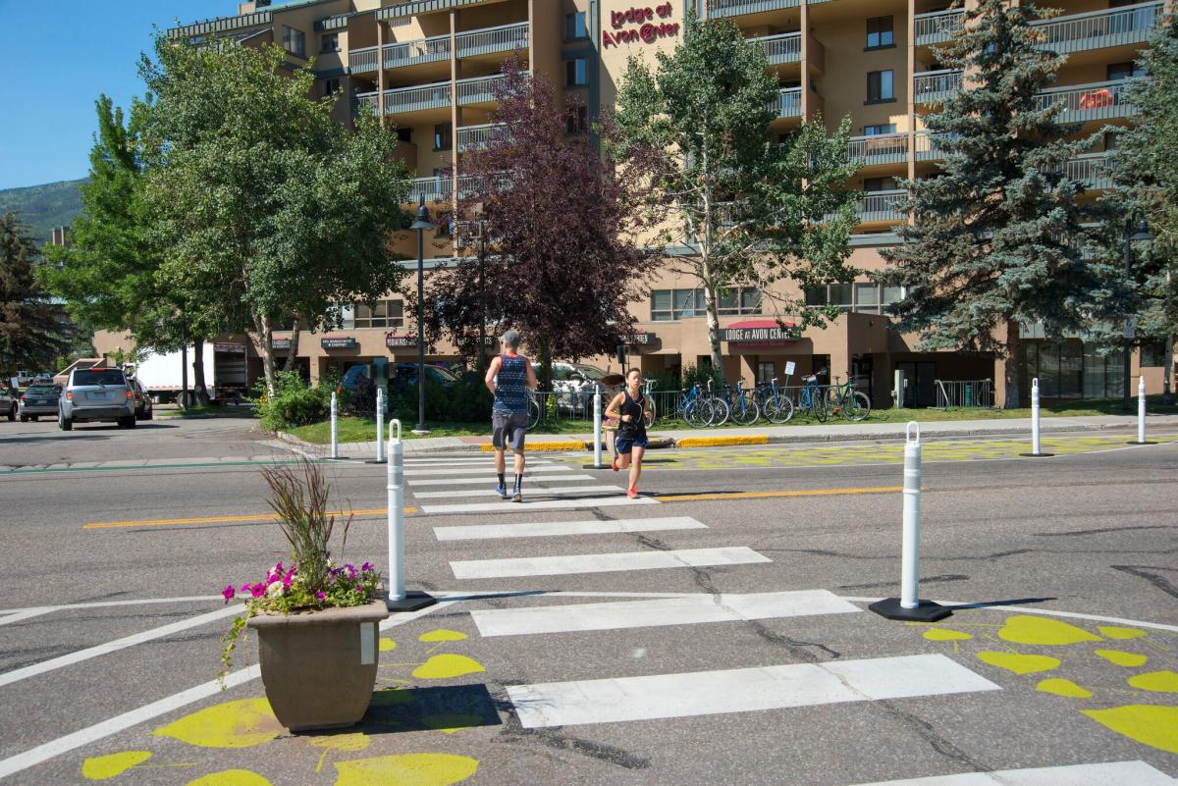
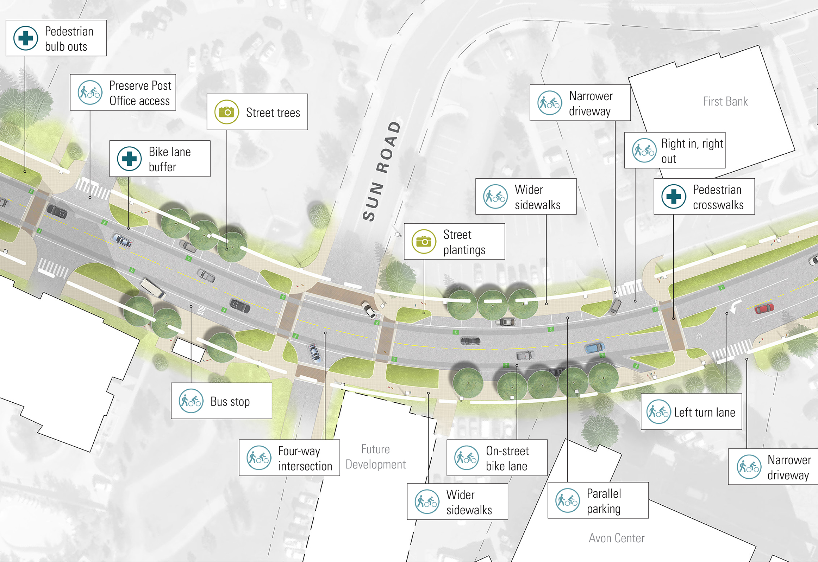
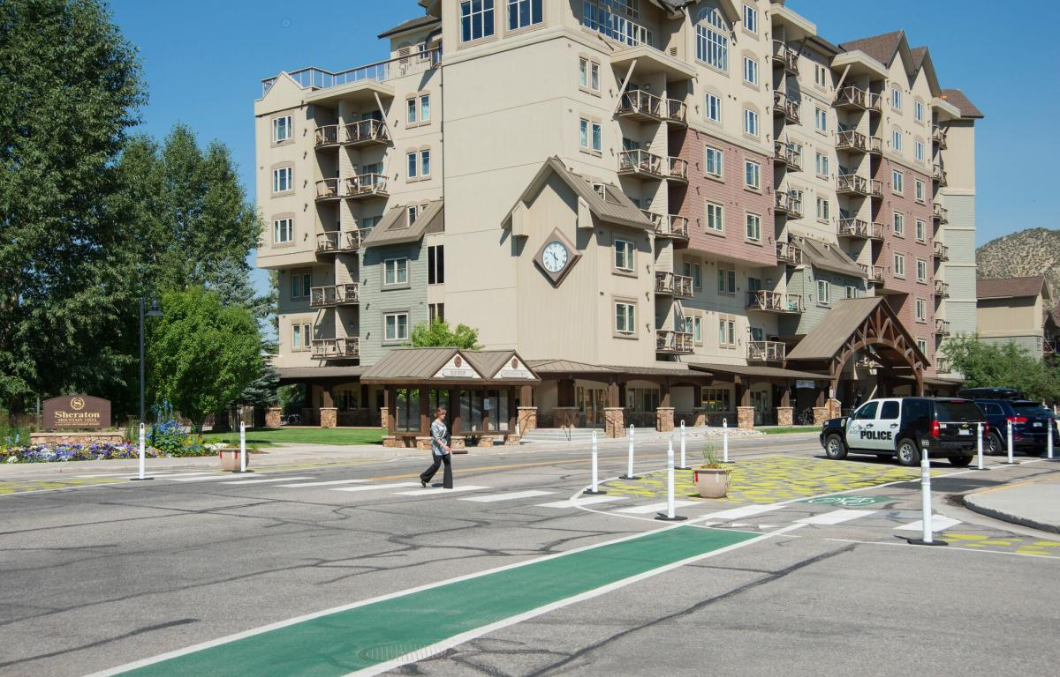
Avon, Co ~ Small Town Tactics
Designs for permanent installation to be completed in 2019
Test in 2016
Notes:
https://www.cnu.org/what-we-do/build-great-places/small-town-tactic
Mostly suburban style streets – pop. 6,541
Built overnight - temporary landscaping, tubular markers, and color paint designs, the team narrowed travel lanes, reduced the size of intersections, created bulb-outs, and provided dedicated bike lanes and on-street parking.
The test was carried out during the summer of 2016 and followed by a September meeting to get public feedback. Nearly every resident in Avon was aware of the project. The public was engaged with signage, walking tours, meetings, public comment emails, and digital preference voting. In civic environments where change is often met with opposition, temporary small-scale interventions can help evaluate the validity of design ideas and build momentum for catalytic change.
Monitored, gathered data, refined designs, approved designs, implementing

