Slide 1
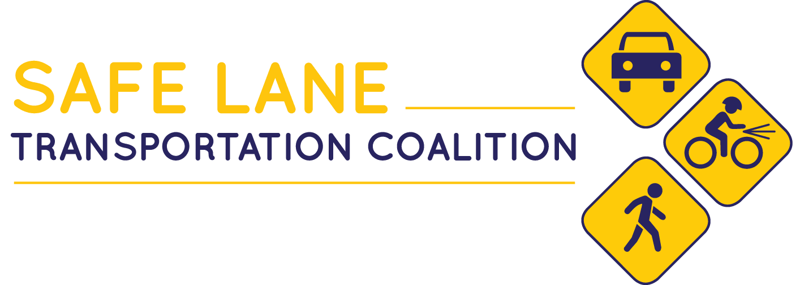
Notes:
Good afternoon everybody and thank you for the opportunity to speak in front of you today.
My name is Drew Pfefferle and I am the Safe Lane Transportation Coalition Coordinator.
I’m here today to talk about the Safe Lane Coalition----- I will give a bit of back ground information------- what we accomplished in 2018--------- some of the projects we have going on in 2019.

Slide 2
Background
The Safe Lane:
A Safety Action Plan
Notes:
In 2015, Lane Council of Governments (LCOG) and Lane County began working on a Regional Transportation Safety and Security Plan.
The goal of the plan was to enhance and prioritize safety throughout the region and to recognize and value the importance of every life traveling on our transportation network.
After approximately 2 year of the planning process, The Safe Lane, Safety Action Plan was adopted in April 2017.
The plan aims to views traffic crashes as preventable incidents that can be addressed in a systemic way.
The Plan establishes a vision and goals for the region that set the groundwork for systematic changes to our transportation system.

Slide 3
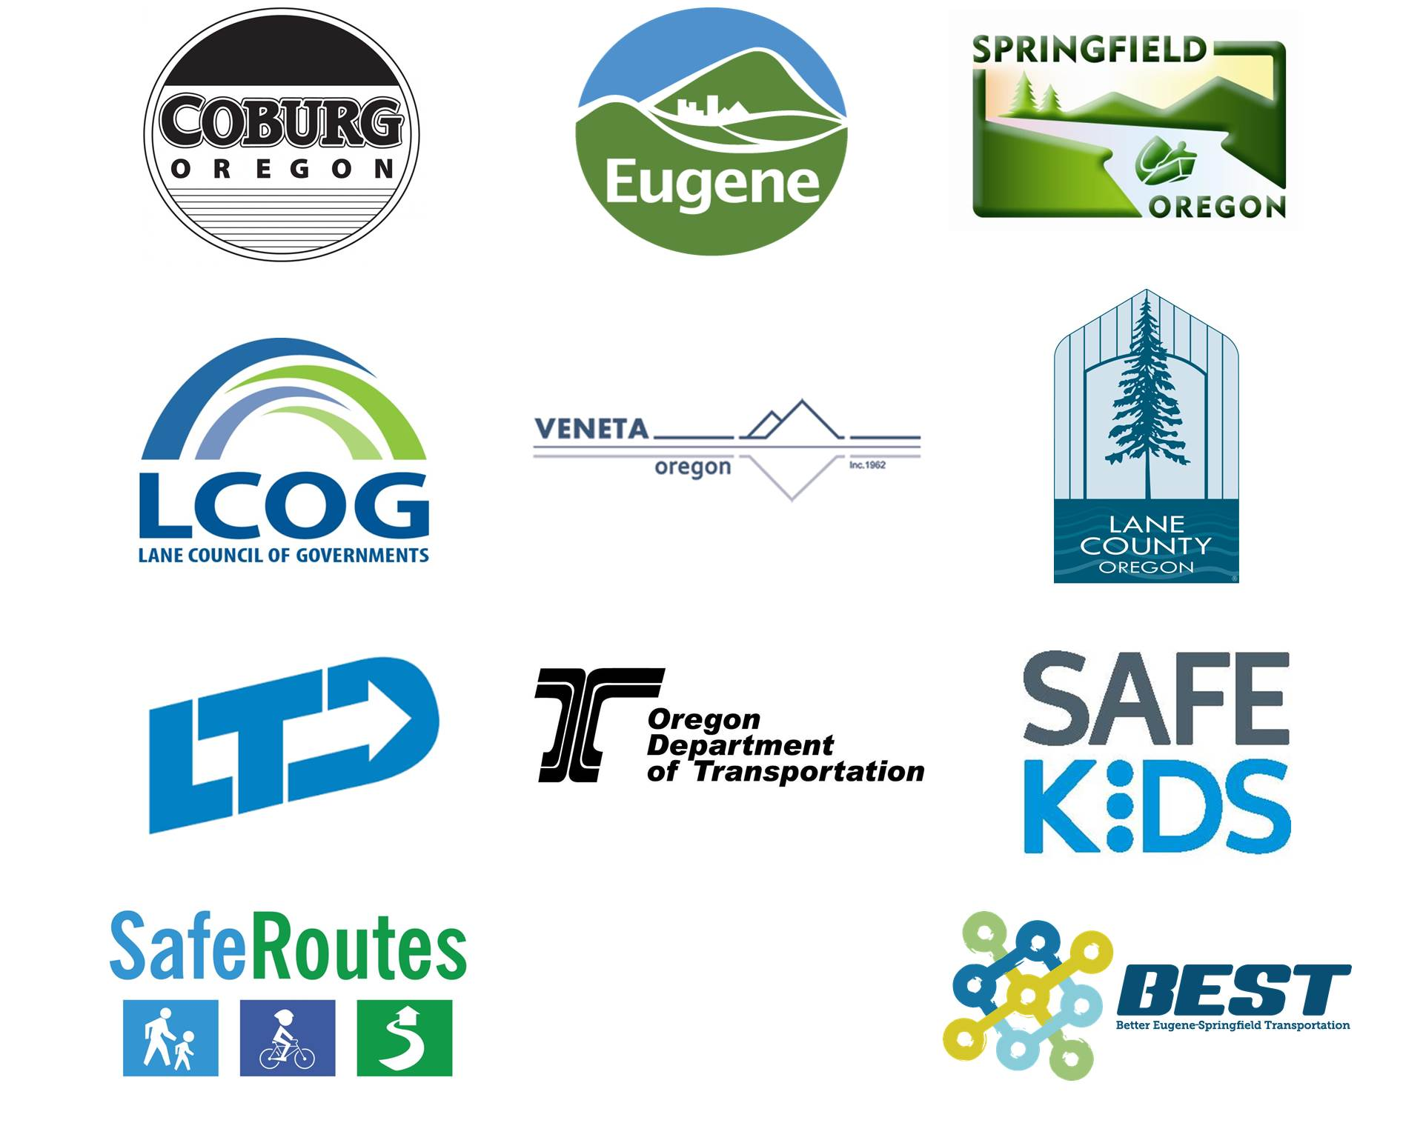
Safe Lane Coalition Members
Notes:
The Safe Lane action plan is the cornerstone document that the Safe Lane Transportation Coalition is founded on. The Coalition works to implement the systematic changes outlined in the Action Plan to eliminating deaths and life-changing injuries on Oregon’s transportation system.
The Coalition currently consists of the 12 organizations displayed here. These organizations together to implement the Safe Lane Action Plan and improve safety on our streets and rural roads.
SLTC PARTNERS
The SLTC currently includes:
Lane County
City of Coburg
City of Eugene
City of Springfield
Lane Transit District
ODOT
Safe Kids West Oregon
Lane Council of Governments
Other interested organizations are encouraged to consider joining the effort.

Slide 4
Resources

Slide 5
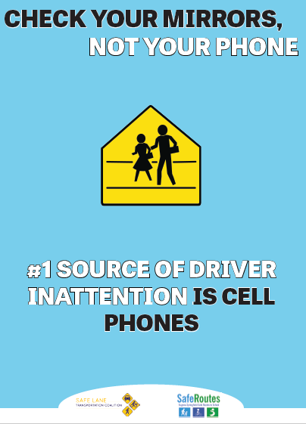
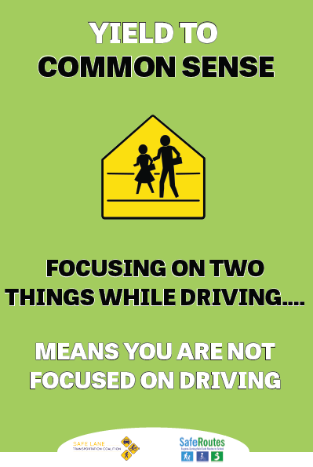
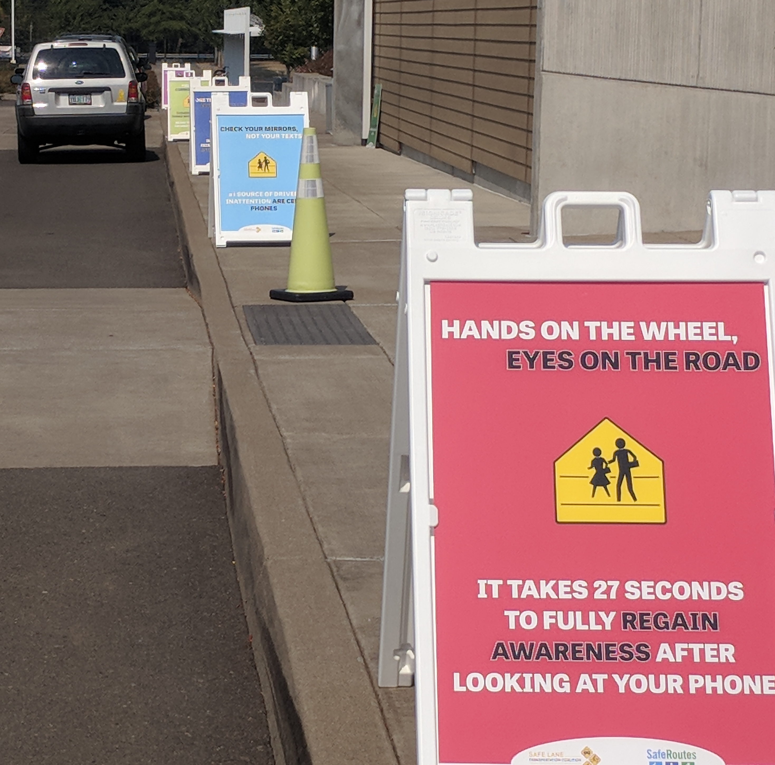
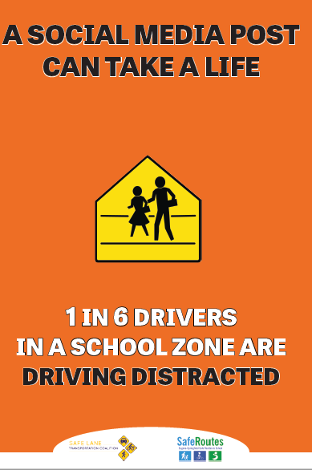
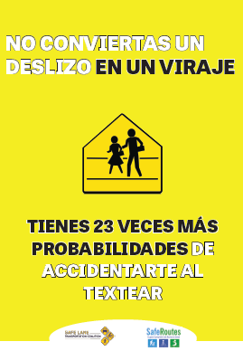
Partnership - Safe Routes To School

Slide 6
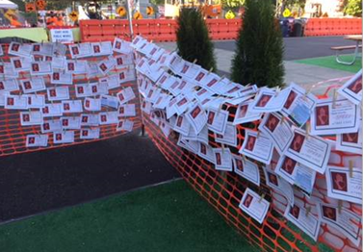
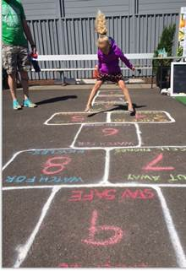
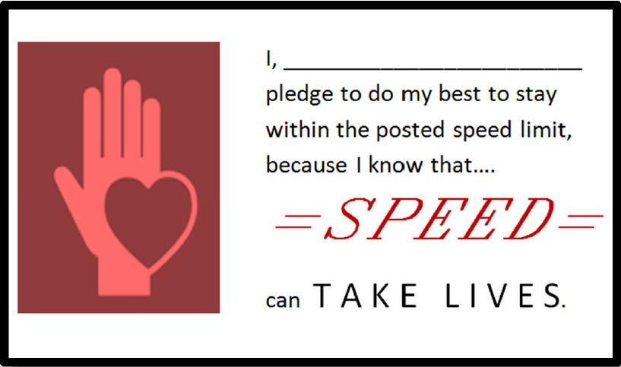
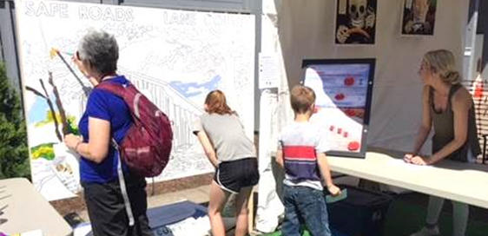
Partnership - Lane County

Slide 7
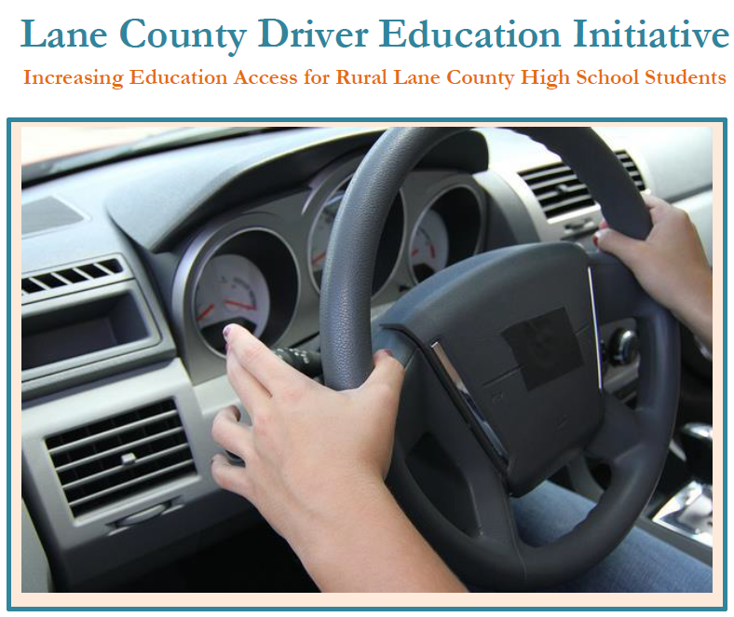
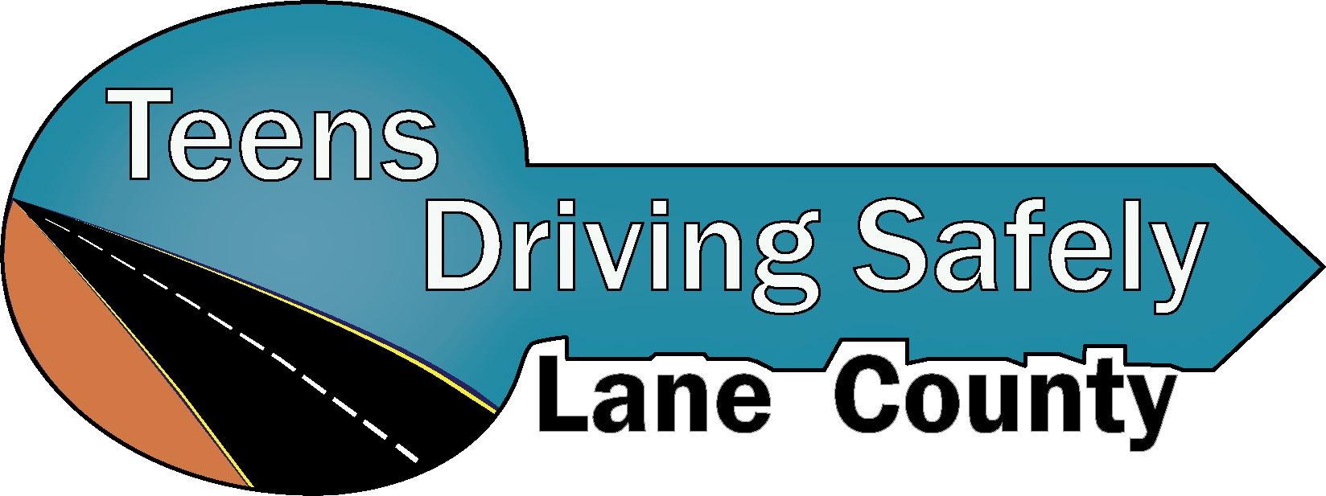
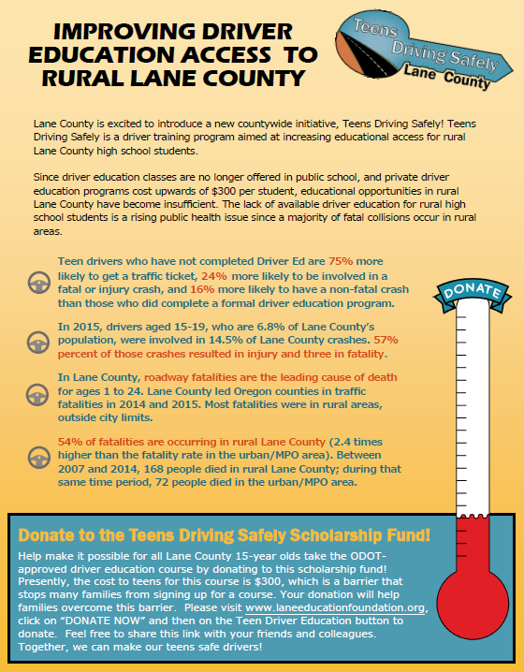
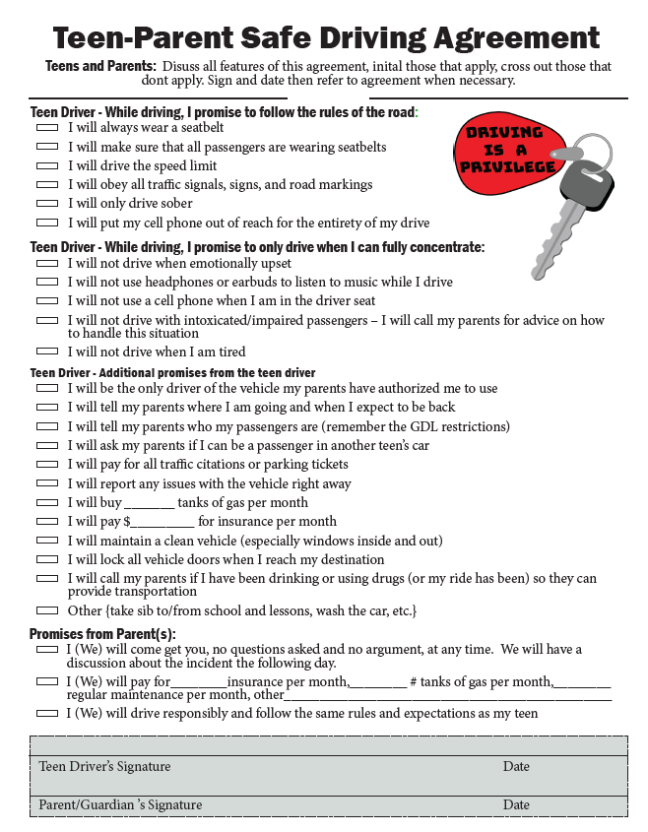
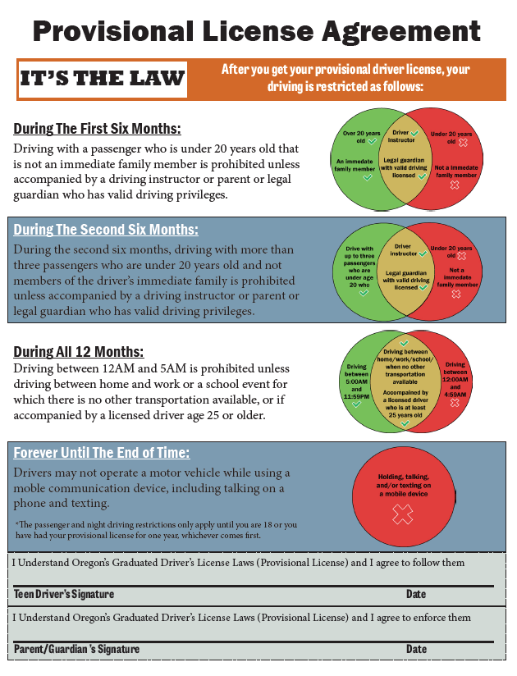
Partnership - Teens Driving Safely
Notes:
The Oregon Department of Transportation awarded the Lane Education Service District a grant to support a new drivers education initiative.
The overall goal of the initiative is to bring drivers ed courses to all high schools in Lane County by partnering school districts and private driving schools.

Slide 8
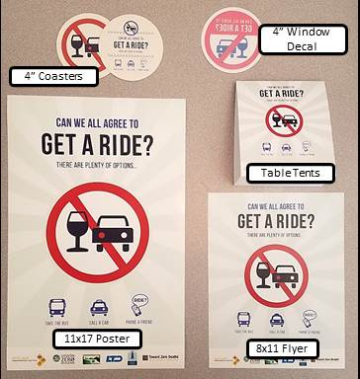
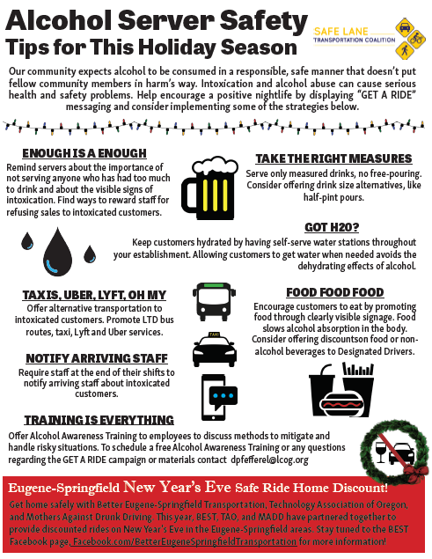
Partnership - Lane County Public Health
Get A Ride reinforces our community’s expectation that alcohol should be consumed in a responsible manner and remind everybody there are plenty of options for getting home safely

Slide 9
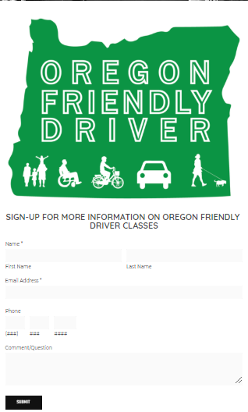
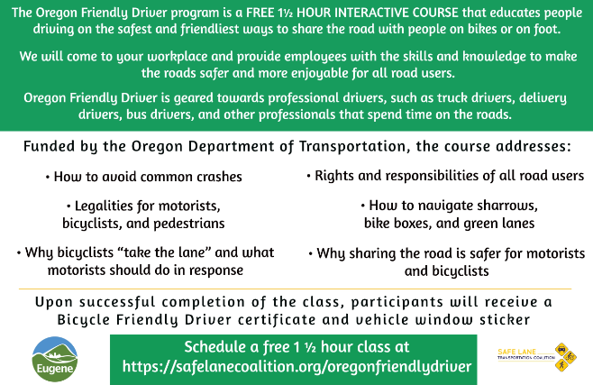
Partnership - City of Eugene

Slide 10
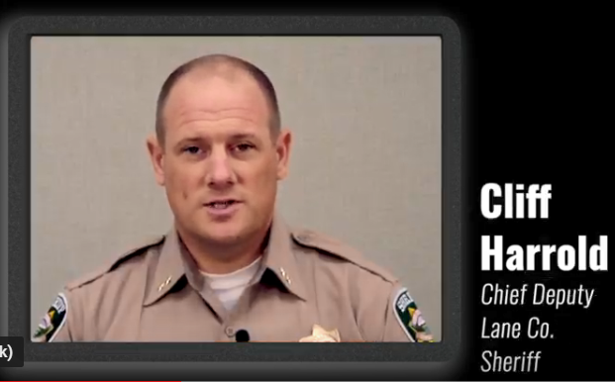
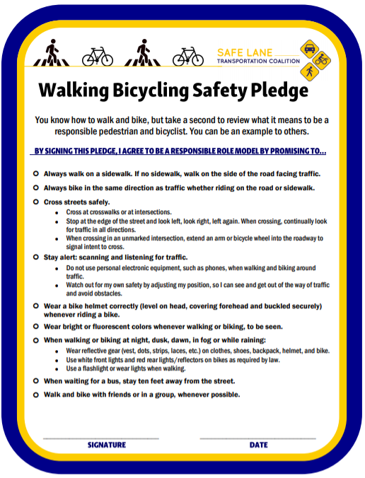
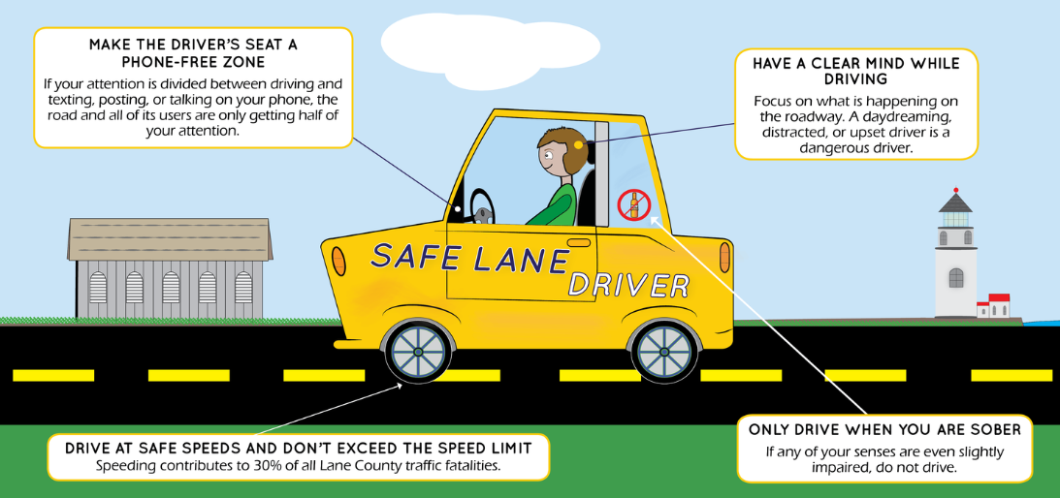
Partnership - Better Eugene Springfield Transit

Slide 11
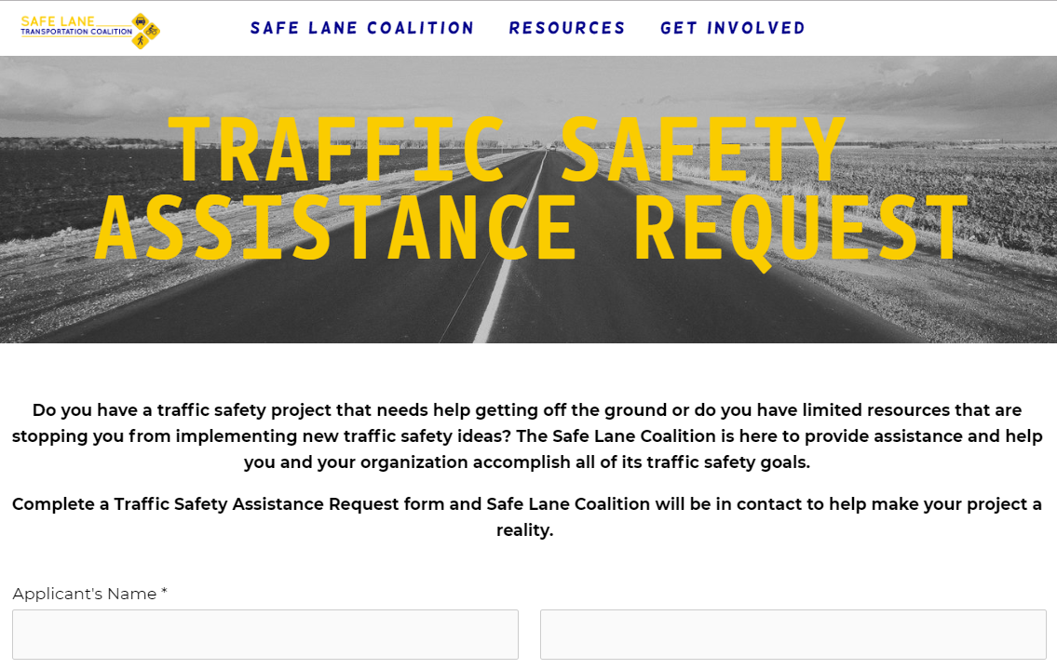
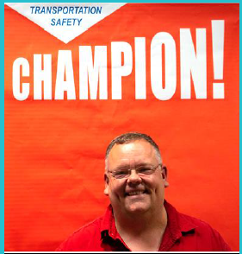
2019 and Beyond
REQUEST FORM
MARIJUANA DRIVING PREVENTION
SPEED REDUCTION INITIATIVE
VOLUNTEER PROGRAM

Slide 12
Questions
Drew Pfefferle
Safe Lane Transportation Coalition Coordinator
dpfefferle@lcog.org

