Slide 1
ODOT Speed Zones
Oregon Transportation Commission
January 2019
Notes:
I’ll be discussing how speed limits are set in Oregon according to our statutes, rules, and policies, as well as processes and timelines.

Slide 2
How are speeds set in Oregon?
Statutory versus designated speeds
Statutory
Statutory
15 MPH
20 MPH
25 MPH
Need investigation to determine
55 MPH
65 MPH
70 MPH
*Designated may be any speed or if roadway does not meet statutory requirements
Notes:
This slide shows those statutory speed limits on the lower and upper ranges. The grey area, between 30 and 50 mph, is where an investigation and analysis is needed to determine the best speed for any particular roadway.
Other speeds such as 25 mph can be designated where the statutory definition is not met or speeds lower than statutory can be designated (i.e., 55 mph) in higher speed areas such as on the interstate.

Slide 3
Designated Speeds Requirements of the statutes
Requires engineering investigation
Investigation concludes current posted speed unsafe
Notes:
Statutes for designating speeds requires an investigation supporting the new speed.
Requires Engineering Investigation – gather objective and unbiased data to evaluate conditions as they exist today.
Investigation indicates that the current posted speed is greater than is reasonable or safe for the given conditions.
The requirements for the investigation are covered in OAR but those can be modified and even conditioned for different roadways.

Slide 4
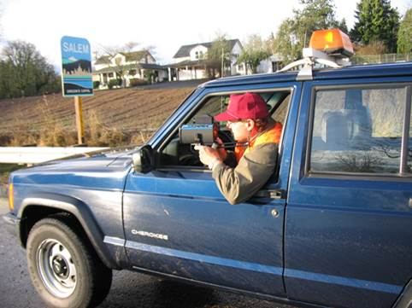
Speed Zone Investigation
Collected, compiled, analyzed:
Collected, compiled, analyzed:
Roadside character
Roadside character
Traffic mix & volume
Traffic Mix & Volume
Crash data
Crash Data
Roadway widths
Roadway Widths
Travel speeds
Notes:
A little more depth about what goes into determining the best speed limit:
In the office, data is gathered and compiled including crash counts, volume history, current mapping, functional class and
Data is collected in the field via photos and observations, includes roadside character (rural, light industrial, commercial businesses); lane and shoulder widths; curves, hills, and grades, speeds of vehicles.
One of the most important factors in determining a speed limit is existing speeds of vehicles, 85th percentile, average speeds and also pace limits.

Slide 5
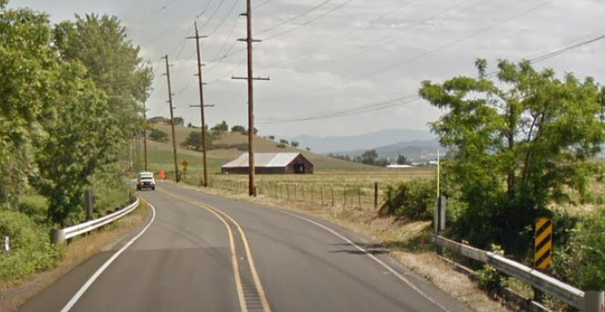
Current speed setting practices
Relies on 85th percentile speeds
Number of crashes, geometry and context
More flexibility in urban areas
Post speeds typically below 85th percentile
Operating speeds typically 5 to 7 mph over posted

Slide 6
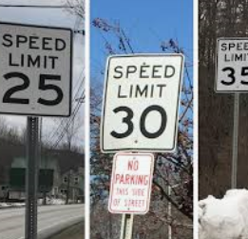
National speed setting practices
Similar to Oregon Practices-
85th percentile
Other factors considered
Rural roads versus urban roads
Notes:
National Speed Setting Practices appear to be very similar to what ODOT is doing.
85th percentile is used by many jurisdictions, but speeds are often posted lower
Practitioners look at other factors than 85th percentile in their studies
The use of 85th percentile is different for rural roads than for urban roads (more flexibility on urban roads)

Slide 7
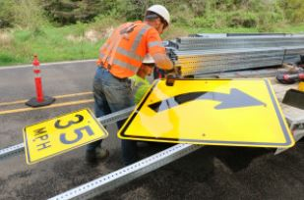
How do we balance all components?
Safety
Compliance
Users
Objective means
Local options
Notes:
Each component is necessary to gain acceptance of the public
Safety is key and the primary reason for setting speeds
Compliance is important without compliance there will be safety problems and enforcement issues
All Users must be considered especially vulnerable users who are more susceptible to harm from non-compliance
Objective Means is a requirement of the statute and helps with other components
Local Options is important to give communities some options to meet their unique needs and desires

Slide 8
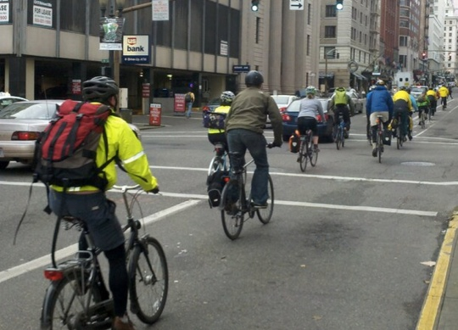
Recent and current efforts
Research and Surveys
NCHRP 17-76/855
NTSB Report
TTI and AAA Survey
MUTCD Proposed Changes
Notes:
There are several efforts underway
NCHRP 17-76 is a national effort to determine speed setting best practices using context of the roadway, NHCRP 855 defined context, the designation urban and rural are insufficient to account for the range of context of a highway.
Both TTI and AAA did surveys of current practices of jurisdictions
NTSB published a report that made several suggestions for setting speeds, advocates for removing 85th percentile speed
The National Committee is proposing several changes to the MUTCD in response to the TTI survey and the NTSB report.
Biggest MUTCD change is the change to when the speed should be set to within 5 mph of 85th, on freeways and rural highways

Slide 9
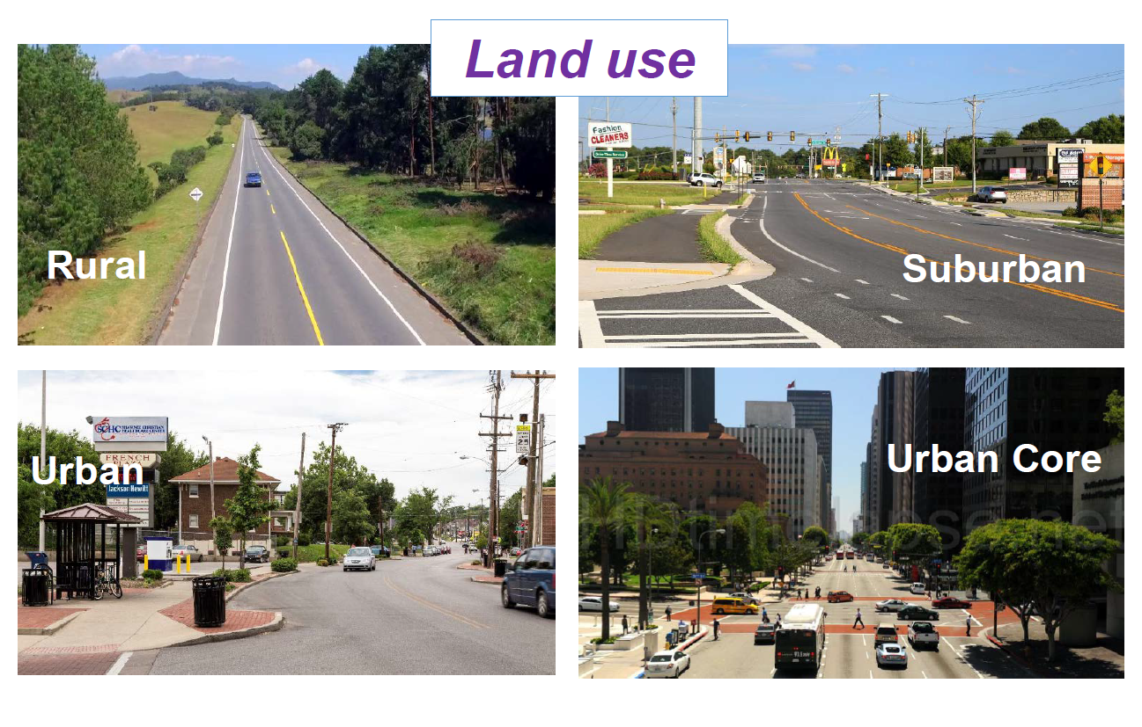
Options for setting speeds
Context NCHRP Report 855
Notes:
NCHRP 855 recommends an expanded functional class system based on five roadway types (freeway, principal arterial, minor arterial, collectors and local) and five context types (rural, rural town, suburban, urban and urban core).
These contexts represent unique context types that require different design practices in terms of operating speeds, access and user groups.

Slide 10
NCHRP 855—Road user priority based on context
Context → Roadway ↓ | Rural | Rural Town | Suburban | Urban | Urban Core
Principal Arterial
Minor Arterial
Collector
Local
User Priority: High Medium Low
Notes:
A new way of looking at functional class across 5 distinct contexts
Linked to desired operating speeds, mobility/access demand and user groups

Slide 11
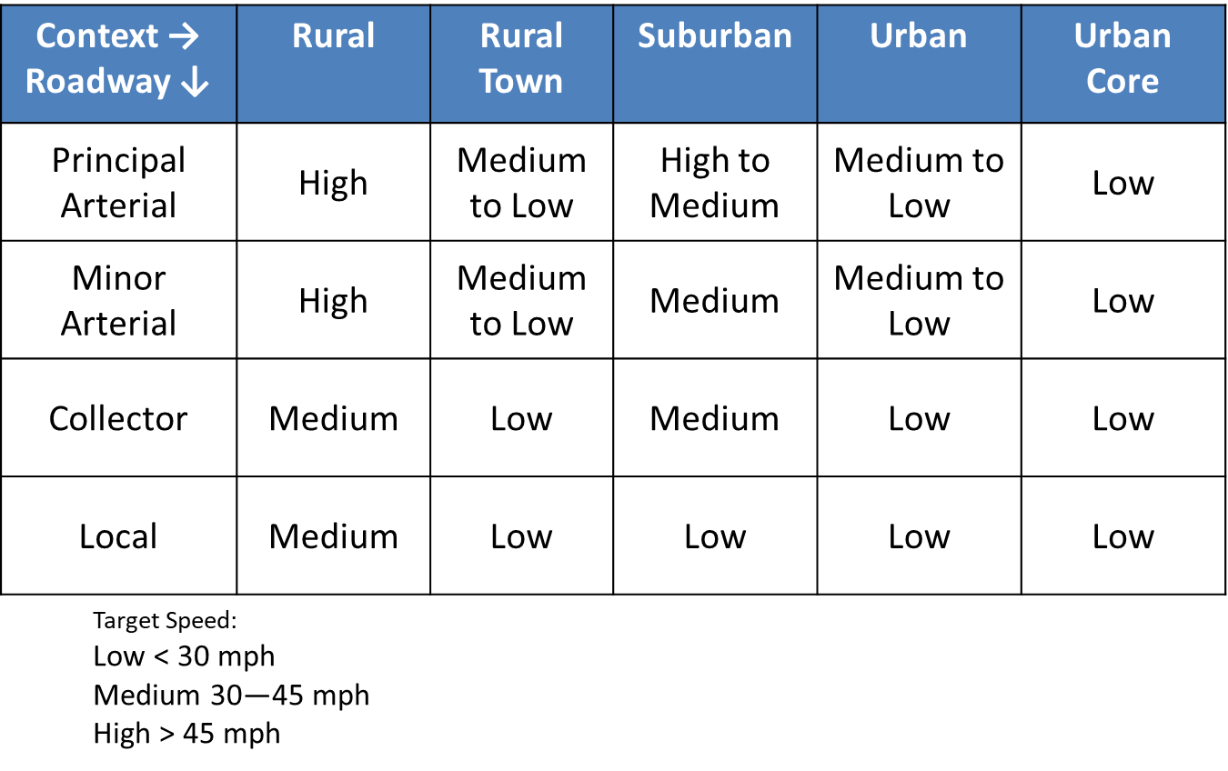
How NCHRP 17-76 is developing guidance
Guidance based upon the relationships between
Speed,
Crashes, and
Roadway characteristics
Context
Vulnerable users
Notes:
Objectives of the study are to identify and describe factors that influence operating speeds and provide guidance to make informed decisions about establishing speeds.
The three conditions they are focusing on are rural high speed highways (excluding freeways), rural to urban transitions and urban/suburban streets.
Updated guidelines to establishing posted speeds:
Relationship between operating speeds, posted speeds and safety
Relationship of speed measures (85th percentile, average speed, pace), context, and factors for setting speeds
Implications of setting speeds lower or higher than recommended
Decision making process for setting speeds (spreadsheet and software)

Slide 12
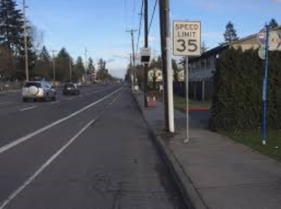
How should we approach changing the way we set speeds?
Seek OTC permission
Form advisory group to recommend potential changes
Look at Portland Pilot
Look at NCHRP 17-76
Bring in national experts for advice
Rulemaking process
Notes:
Go to the Commission first get buy-in for changes to the process and permission to form an advisory group.
The advisory group will delve into the research and begin creating draft rule changes.
Bring in national experts for advice. Consider Dr. Karen Dixon from TTI.
Once the group has a solid draft then the rule making process can begin. The process is typically six months for easy rules, but can take longer for contentious rules.

Slide 13
Timelines
Develop Draft Rule
Feb – June 2019
Rulemaking Process
July-Dec 2019
OTC
Early 2020?
Feb 2019
Advisory Group
July 2019
Rule Process
2020
Approval
April 2019
National Experts
Aug 2019
File w/ SS
May 2019
Final Draft
Sept 2019
Public Meetings
Notes:
This is really the best scenario, any number of things tend to hold up the process, once you have proposed text that is close to the final format the OAR process can begin and many of the processes can run concurrently, but there can be hold ups if concerns come up.

Slide 14
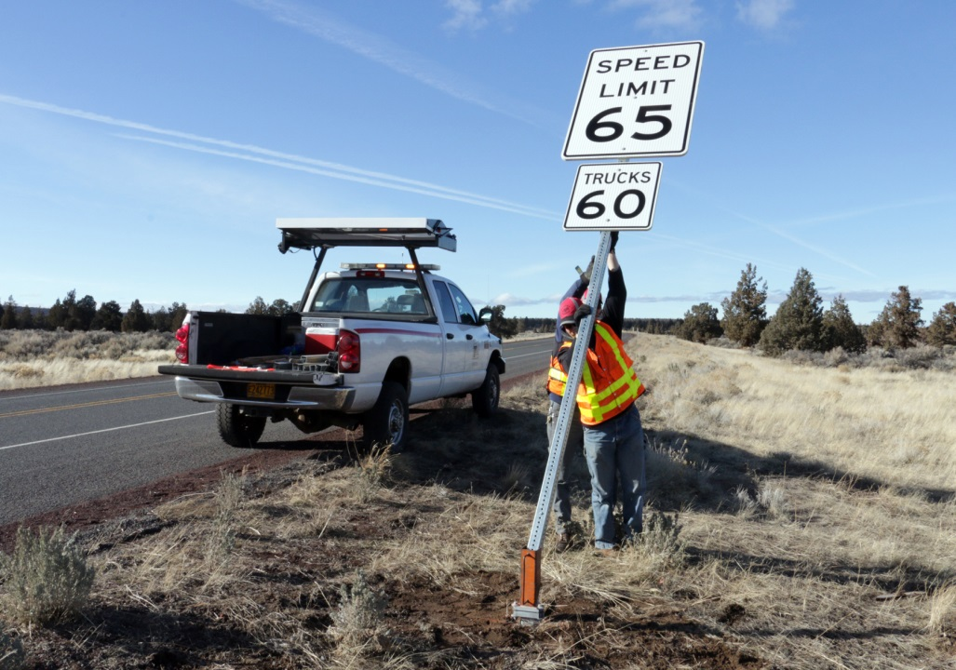
Questions?

